Slide 1
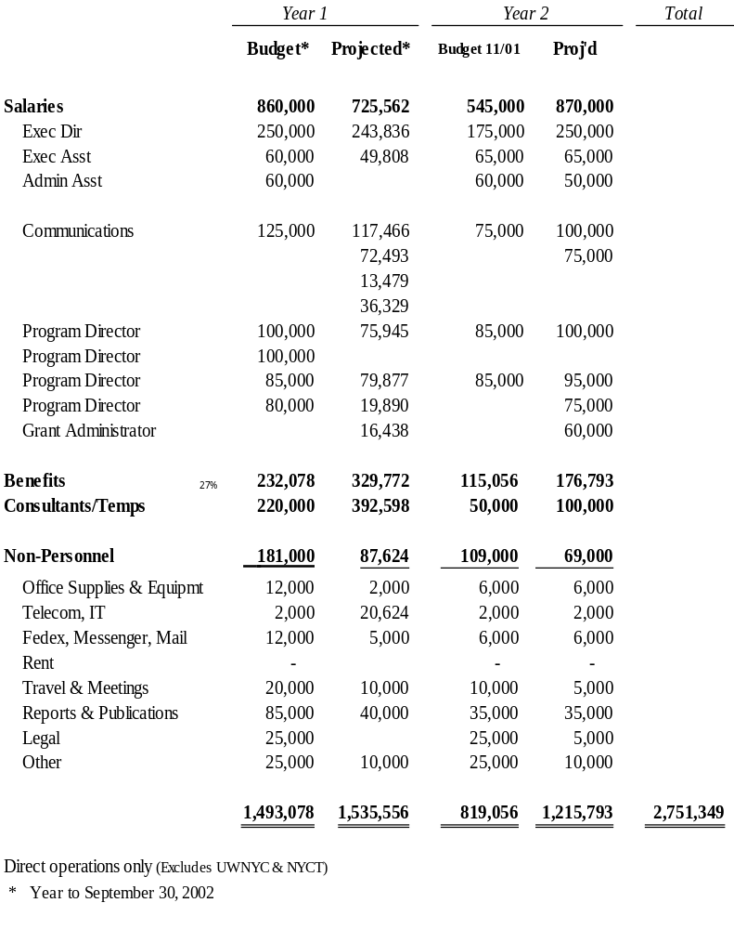
Potential Revisions to Administrative Budget
September 11th Fund has been operated as a small organization, relying on services donated by NYCT, UWNYC and others.
Original budget assumed program development and grantmaking largely complete in first year. Second year activity primarily for monitoring with reduced staff.
First year totals should be consistent with budget. However, communications expenses were much more than budgeted; these were offset by in-kind contributions for program development and other costs.
In light of this year’s experience, recommend greater Year 2 budget amounts than previously planned for program staff and communication.

